Slide 1
Media Literacy
Grade 4

Slide 2
Media Literacy
is the ability to access, analyze, evaluate and create media messages of all types.

Slide 3
Media Literacy Video (Brain Pop)
https://www.brainpop.com/technology/digitalcitizenship/medialiteracy/

Slide 4
Slogans
Logos

Slide 5
Newspapers:
Attention grabbing headlines
Exciting photos often in color
Information about our community, our country and the world
A variety of sections: Sports, Business, etc.

Slide 6
Purpose of the

Slide 7
documentary

Slide 8
Magazine ad

Slide 9
News Report

Slide 10
Online news site
https://www.dallasnews.com/

Slide 11
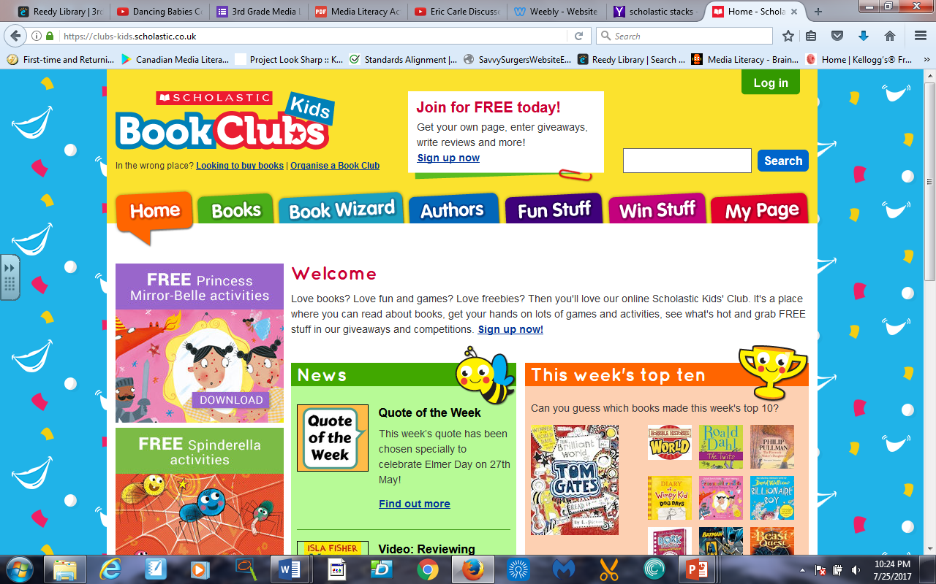
https://clubs-kids.scholastic.co.uk/

Slide 12
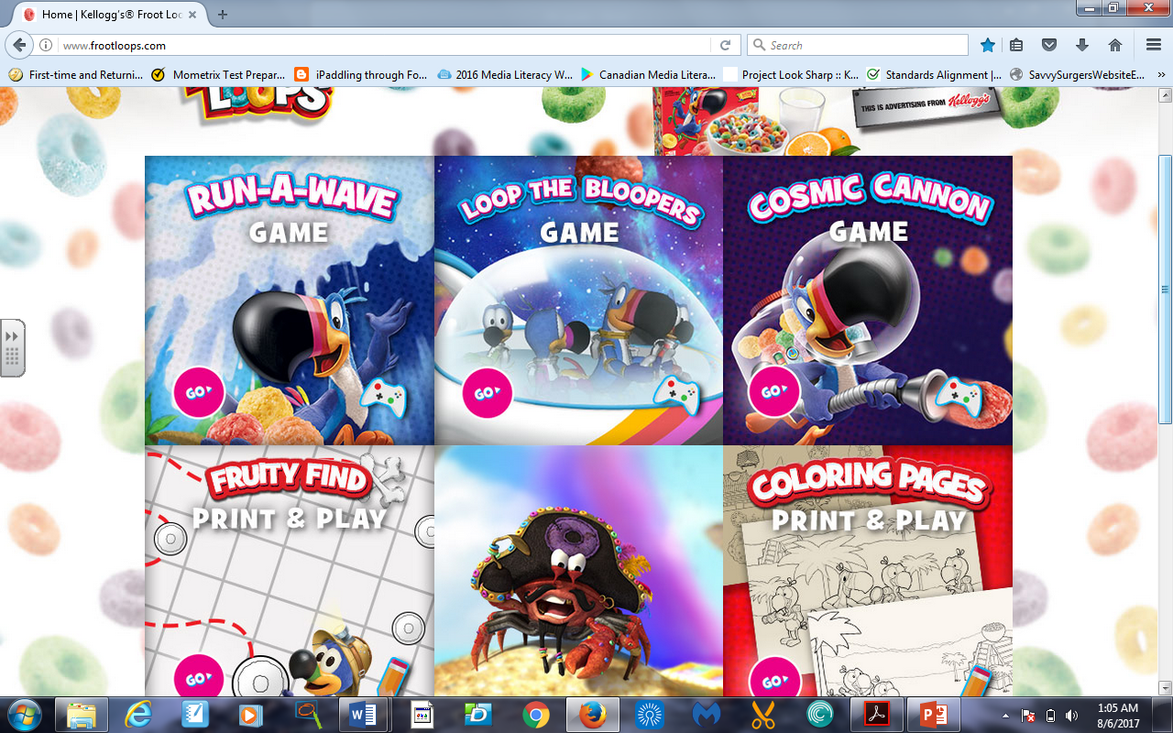
Advergame www.footloops.com

Slide 13
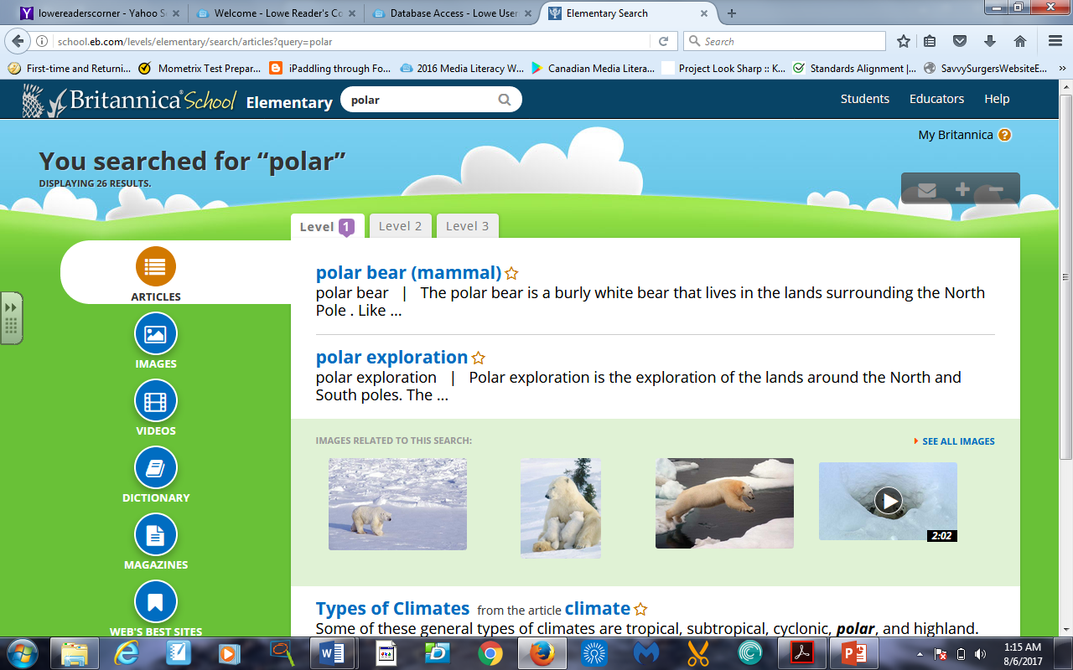
Database: To find go to the Britannica database through Lowe Reader’s corner webpage
http://school.eb.com/levels/elementary/search/articles?query=polar

Slide 14
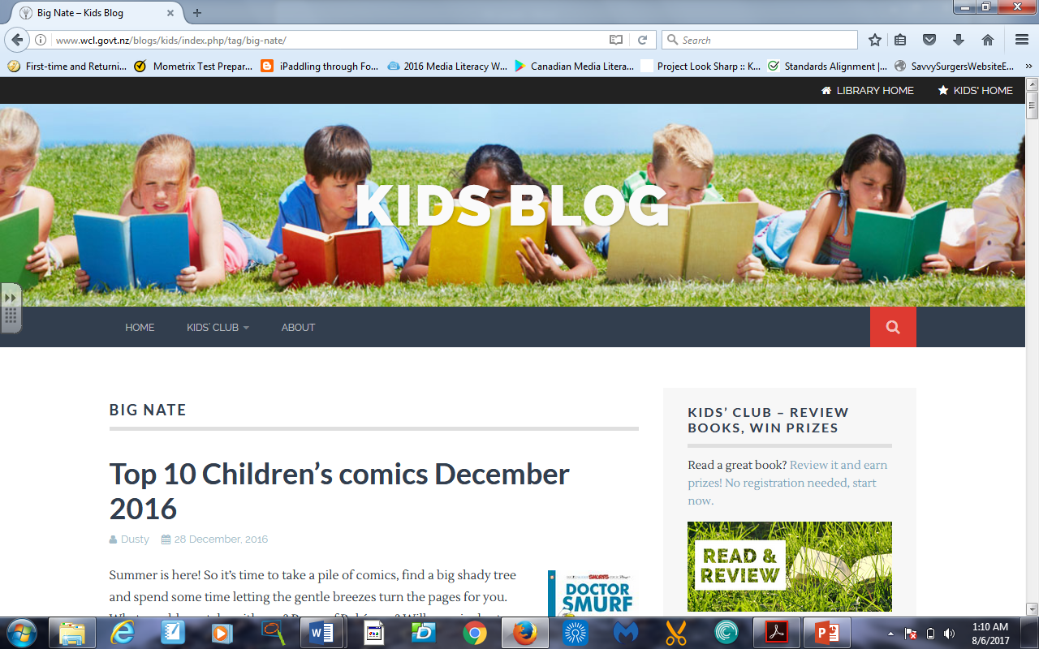
Blog
http://www.wcl.govt.nz/blogs/kids/index.php/tag/big-nate/

