Slide 1
Media Literacy?
Defined
5th Grade

Slide 2
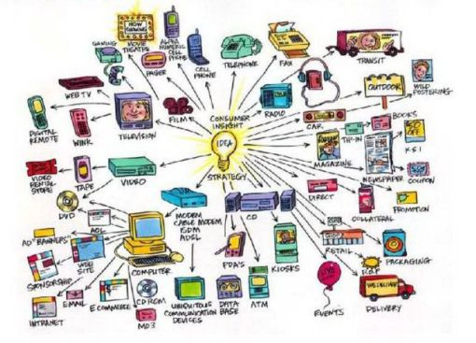
Media

Slide 3
Media used to communicate to people:

Slide 4
Media used to communicate from one person to another:

Slide 5
Media used for entertainment:

Slide 6
What is literacy?

Slide 7
Media Literacy Process Skills

Slide 8
Media Literacy Process Skills

Slide 9
Media Literacy Process Skills:

Slide 10
Media Literacy Process Skills:

Slide 11
Media Literacy Process Skills:

Slide 12
Tools used in Media
Images and pictures
Text and words
Music and sound
Graphics
Video
Interviews

Slide 13
Visual Tools

Slide 14
Question: 2
Look at the magazine ad. What are the primary tools being used to advertise this peanut butter brand?

Slide 15
Question: 3
Watch this TV advertisement. What are the primary tools being used to advertised Evain bottle water?

Slide 16
Question: 4
Watch this TV New segment. What are the primary tools being used in this TV news story?

Slide 17
Question: 5
Watch this documentary.
What are the primary tools being used in this documentary about Bill Gates?

Slide 18
Question: 6
Read this online news article. What are the primary tools being used in this online news article
https://www.usatoday.com/story/news/nation-now/2017/07/18/dog-saves-baby-deer-drowning-waters-off-long-island/487646001/

Slide 19
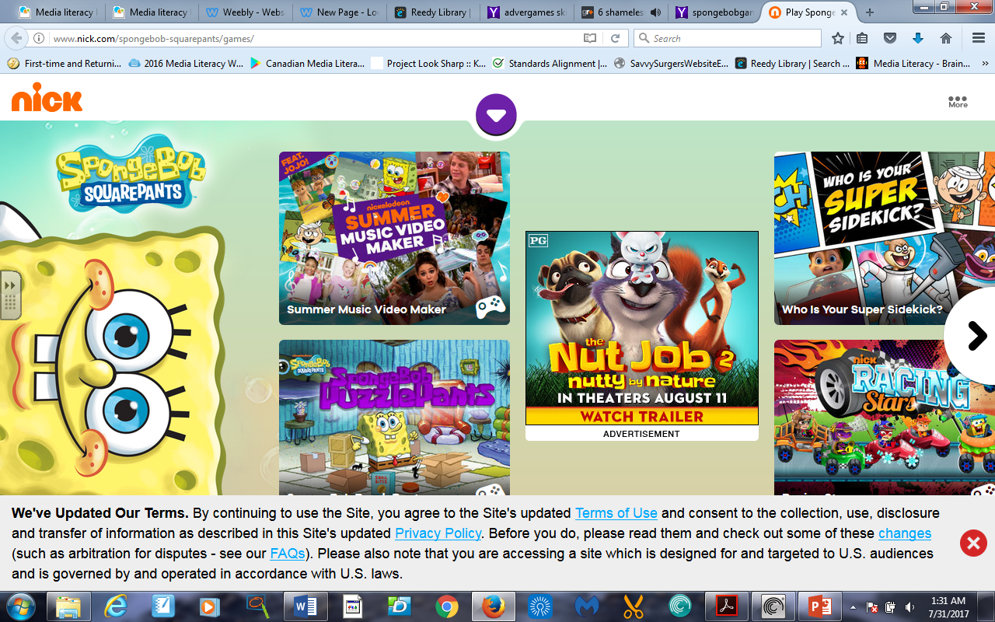
Question: 7
Look at this advergame website.
What are the primary tools being used in this on this site?

Slide 20
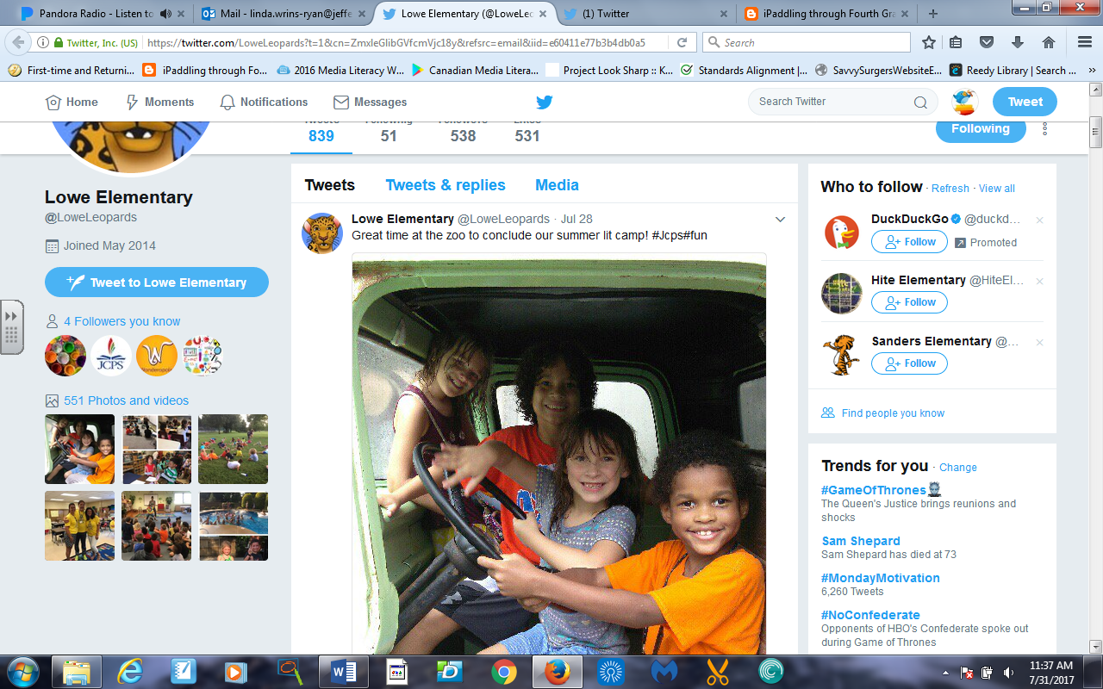
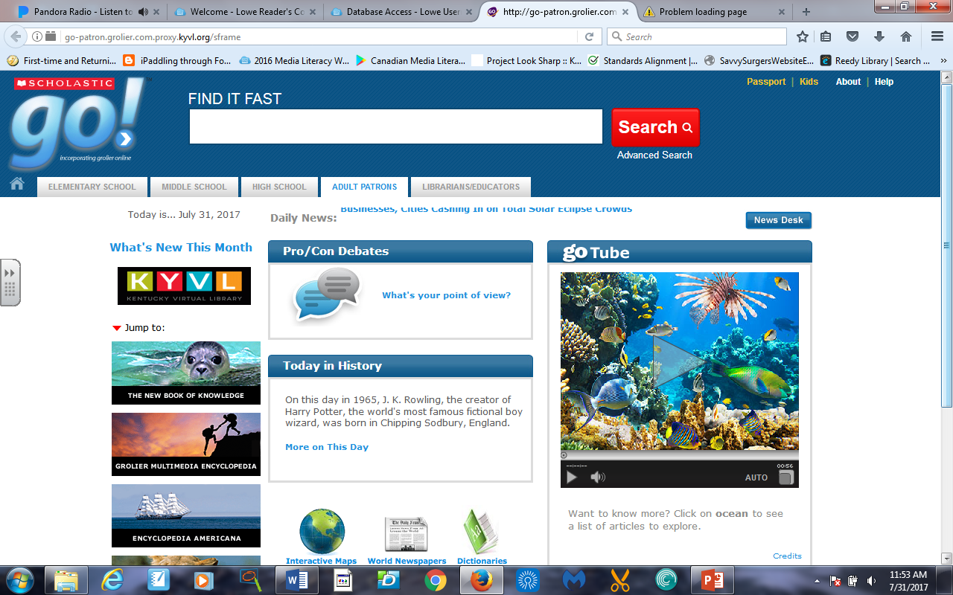
Question : 8
Look at the images of these two websites.
Which one of these is a more formal venue for information? Twitter or Grolier.Online?
http://jcpsky.libguides.com/c.php?g=539294

Slide 21
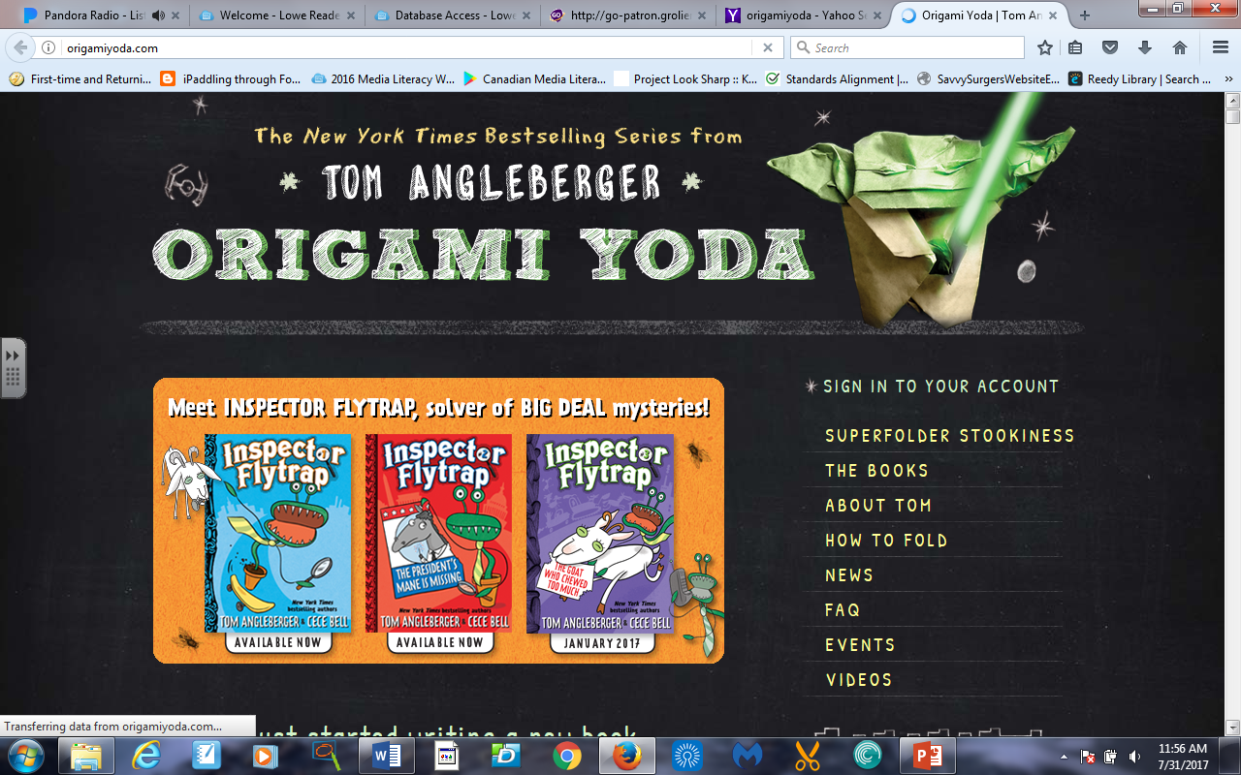
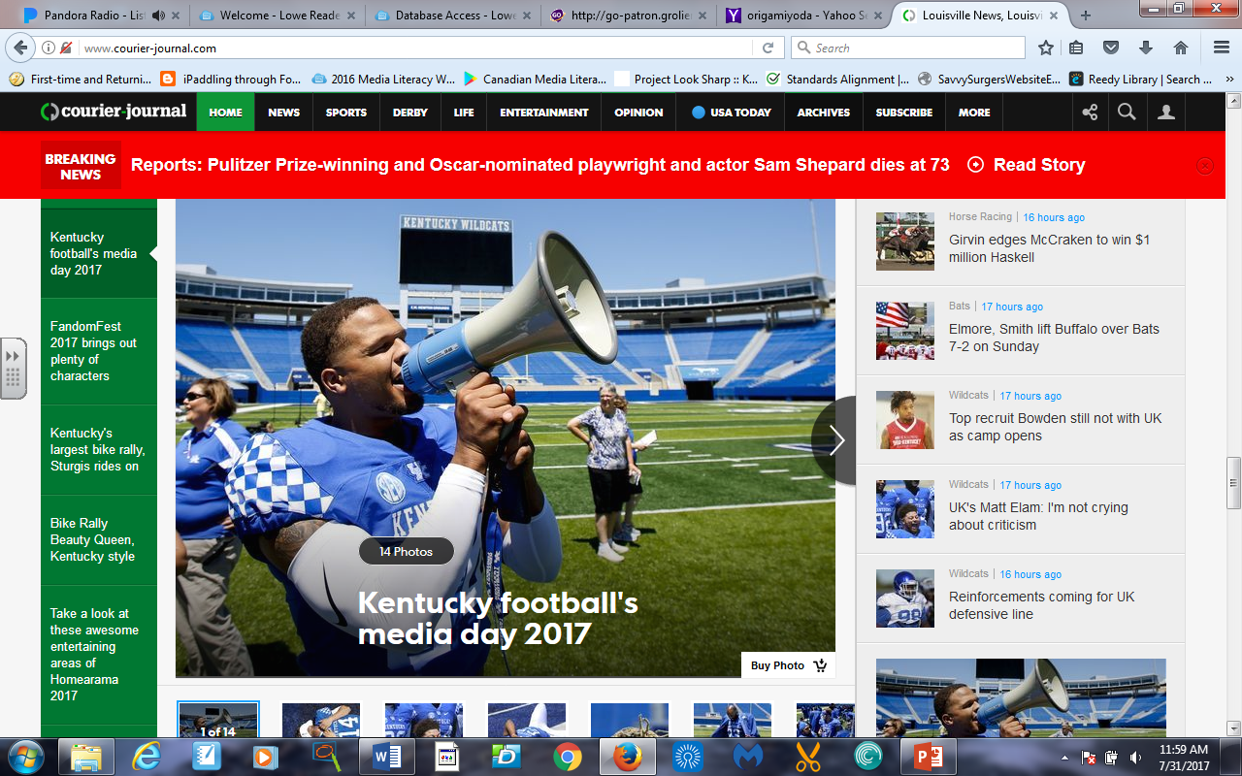
Question: 9
Look at the images of these two website:
Which on of these is a more formal venue for information? Origami Yoda blog or Courier Journal News website?
http://origamiyoda.com/
http://www.courier-journal.com/

