Slide 1
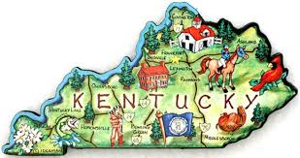
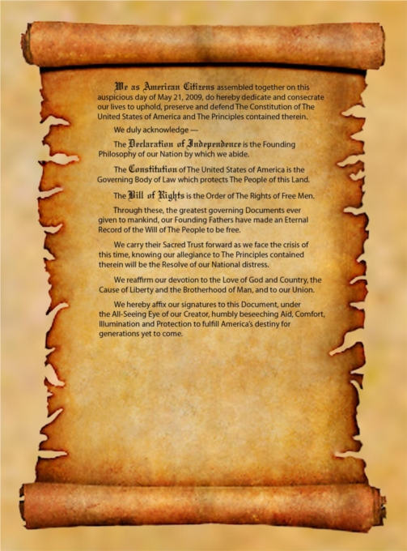

Slide 2
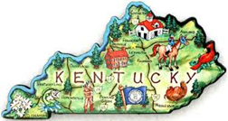
Geography:
Location in relation to Kentucky
Physical Features:
Climate:
Natural Resources:
2 Cities:
Landmarks:
Fun Facts:
Region
How did it get its’ name?
History:
Famous Event
Famous Event
People
Ethnic Groups
Contributions
First Inhabitants
Famous Person
How did they contribute to Kentucky?
Caption
Economy
Cash Crop
Goods & Service
Industries
Famous Person

